Slide 1

Campus Carbon Footprint Analyzer
SDG 13 - Climate Action
Title:
Team Name: CodeAvengers
Team Leader:Surya M
Email: kit26.ad59@gmail.com
Phone: +91 9344859103

Slide 2
Motivation Slide 1:
  Every campus today depends on electricity, transportation, canteens, and other services that quietly add up to a large amount of carbon emissions.
  The problem is most institutions don’t know exactly how much CO₂ they produce or where it comes from.
  Without proper data, it’s difficult to take effective steps toward becoming a sustainable or carbon-neutral campus.

Slide 3
Motivation Slide 2:
  Our main motivation was to build something that actually helps our college take measurable climate action.
  Students, staff, and administrators all play a role in energy use but until we track it, we can’t manage it.
  By building a system that converts daily campus activities into real emission numbers, we can clearly see our environmental impact and start taking steps to reduce it.

Slide 4
Proposed Solution:
  We created a web-based Carbon Footprint Analyzer for our campus.
  It collects data like electricity consumption, transport fuel use, canteen fuel, and waste generation, then automatically converts everything into CO₂-equivalent emissions.
  The system displays all this data on an interactive dashboard, where you can view total emissions, monthly trends, and category-wise breakdowns.
  It even provides practical suggestions on how to reduce emissions like using solar energy, carpooling, or switching to LEDs.
  This project directly supports SDG 13 – Climate Action, helping institutions monitor and act on climate goals in a measurable way.

Slide 5
Our Building Process & Workflow
  Our project is built using Python Flask for the backend and MySQL for the database.
  The dashboard is designed using HTML, CSS, and JavaScript, and the data is processed in Python to calculate emissions using scientific conversion factors.
  Here’s how the process works:
    Admins enter data like monthly electricity use or fuel consumption.
    The system fetches the correct emission factor from the database.
    It calculates the total CO₂ generated.
    The dashboard shows all results visually with graphs and charts.

Slide 6
Impact & Future Scope
  This project can help any college or institution become environmentally conscious and data-driven.
  By knowing exactly where emissions come from, management can take direct action — whether it’s saving electricity, optimizing transport, or reducing waste.
  In the long run, this can support green campus certification, energy audits, and policy-level decisions for sustainability.
  For the future, we plan to:
    Integrate machine learning to predict future emissions based on current trends.
    Add mobile access so data can be viewed anytime.
    Enable CSV upload for bulk data entry.
    Connect to IoT energy meters for real-time updates

Slide 7
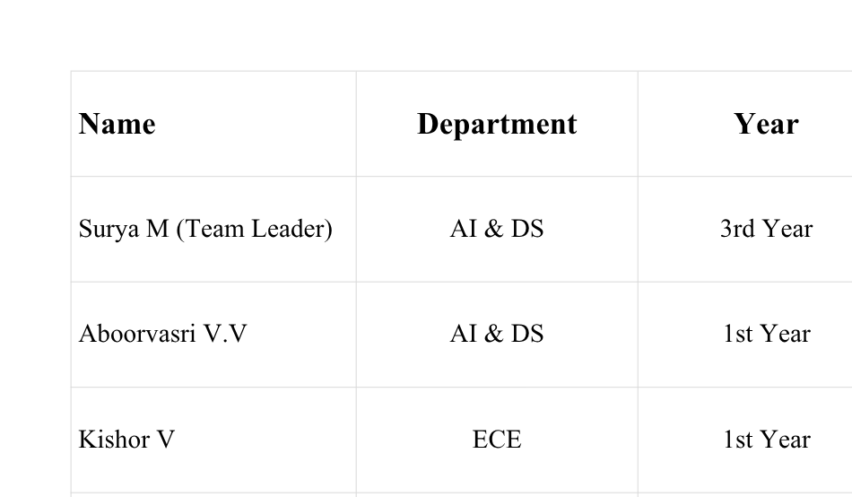
Team Details

Slide 8
Thank You
“Campus Carbon Footprint Analyzer — Measuring today for a cleaner tomorrow. 🌱”

